Slide 1

QUIZ GAME
Made by: Jaskaran Soni

Slide 2

Outline
Introduction
Using language
Motivation
The process to play the quiz game
Methods
Advantages
Future plan

Slide 3

INTRODUCTION
Definition-
A quiz game is a form of entertainment in which the general or specific knowledge of the players is tested by a series of questions, as like as radio or television program or mobile game.
A quiz is a game which can also be called a mind sport where the players, either as individuals or in teams attempt to answer questions. It broaden the horizon of knowledge.

Slide 4

language
Language to use quiz game

Slide 5

Motivation:
We saw a couple of people who know better about python. And we were looking way to end the argument so, we decided to create a python quiz. Later while writing the code for this quiz, we got ideas about how this quiz can help to learn and to measure. Ones, ability or knowledge in any field and it will also be a very good brain exercise.

Slide 6

Process
Game shows the message “welcome to python quiz”
Then It asks for username. The player will write name.
It asks, “You want to play ?” Player will type “YES”
“It will show your username with the message “Lets start the quiz”

Slide 7
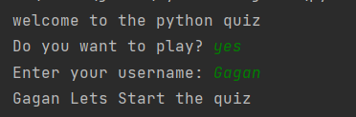
Picture

Slide 8
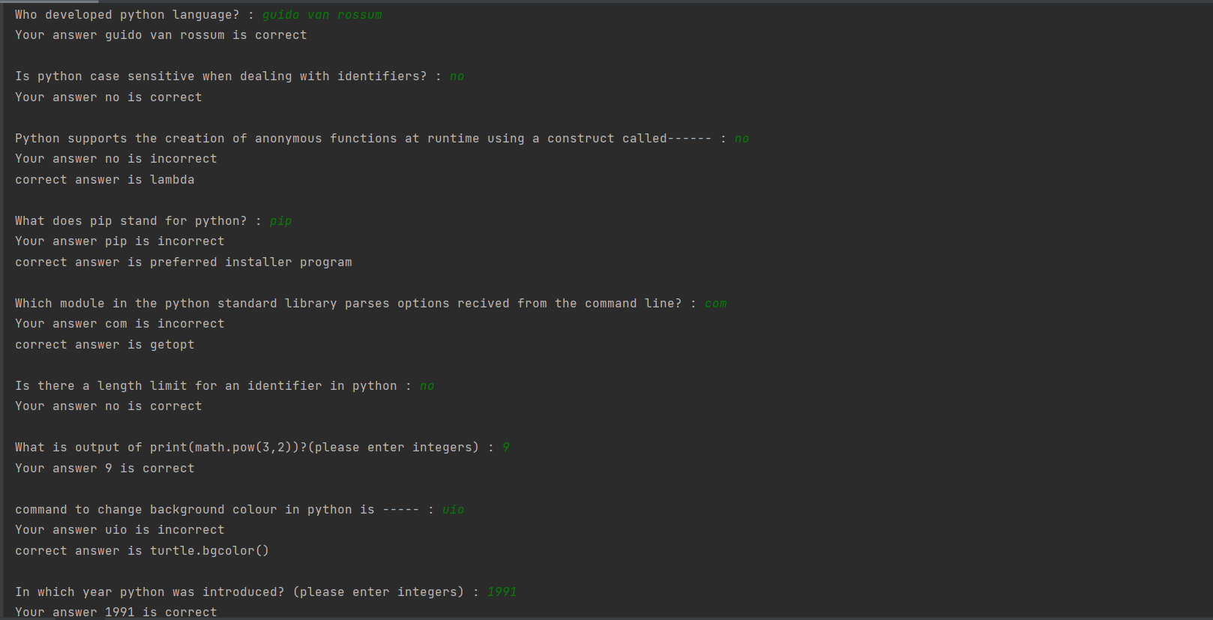
How Questions and Answers appears

Slide 9
Methods
We used if and elif statement mainly.
We added strings.
We used Score command.
We used percentage and other things.

Slide 10
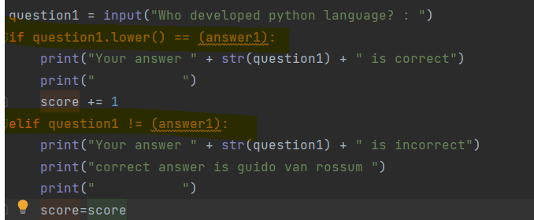
If else statement
We used if statement, if the answer is correct if statement will work and show your answers which we provided, is correct and one point is added to our score. On the other hand, if our answer is incorrect then the elif statement will work and show our answers are incorrect and show the right answers and our score will remain the same.

Slide 11
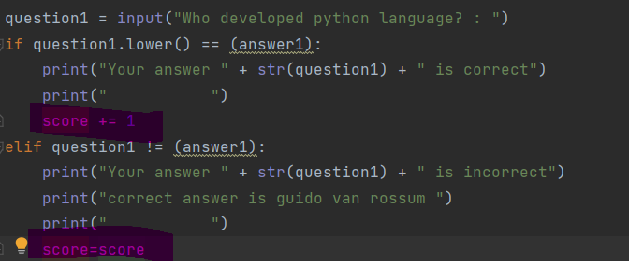
Score command:
We used this command to keep track of the points, or the number of questions answered correctly.

Slide 12
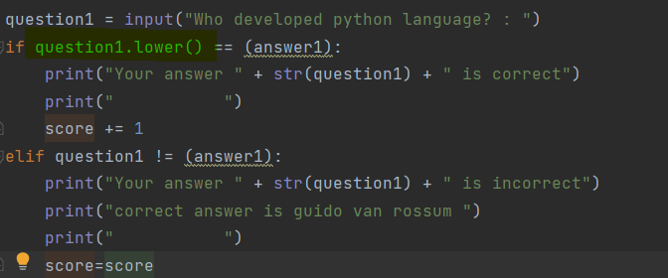
Lower command
If the person provides the answers in lowercase or uppercase, it will convert the answers to lowercase. Giving the freedom to answer in uppercase and lowercase.

Slide 13
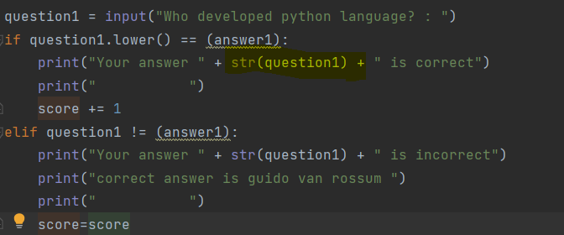
Adding String :
We used the string command to edit the answer. Now the answers we provide will be shown below.

Slide 14
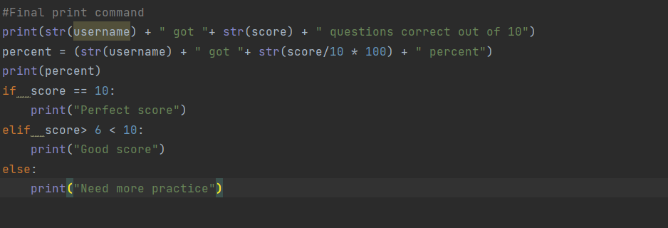
Final print command :
We used the first print command to print the score of the player.
The second print command is used to print the percentage.
Finally, if, elif and else are used to tell how you performed on the quiz.

Slide 15
Advantages
Develop An Ability To Learn & Compartmentalize Knowledge.
Keeps You Conditioned For Competition.
An Opportunity To Stay Updated On All Kinds Of Information.
Excellent Stress Buster For Everyone.
Develops The Ability To Think Quick On Your Feet.

Slide 16
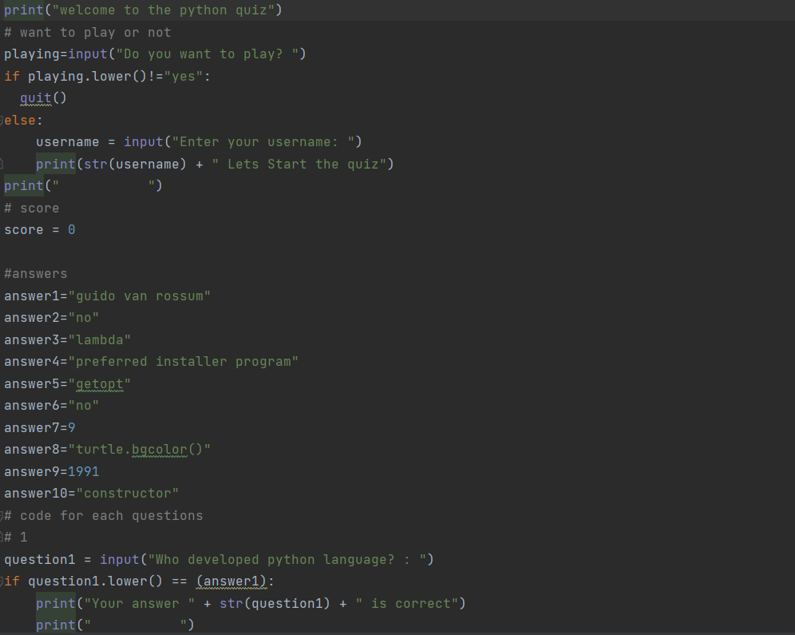
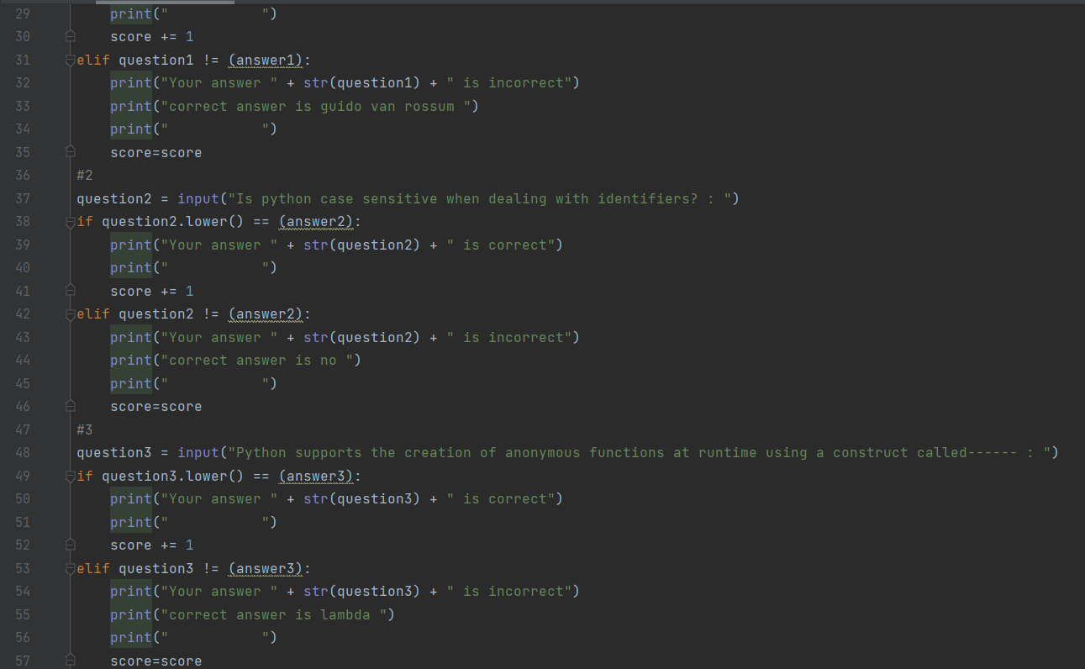
INPUT

Slide 17
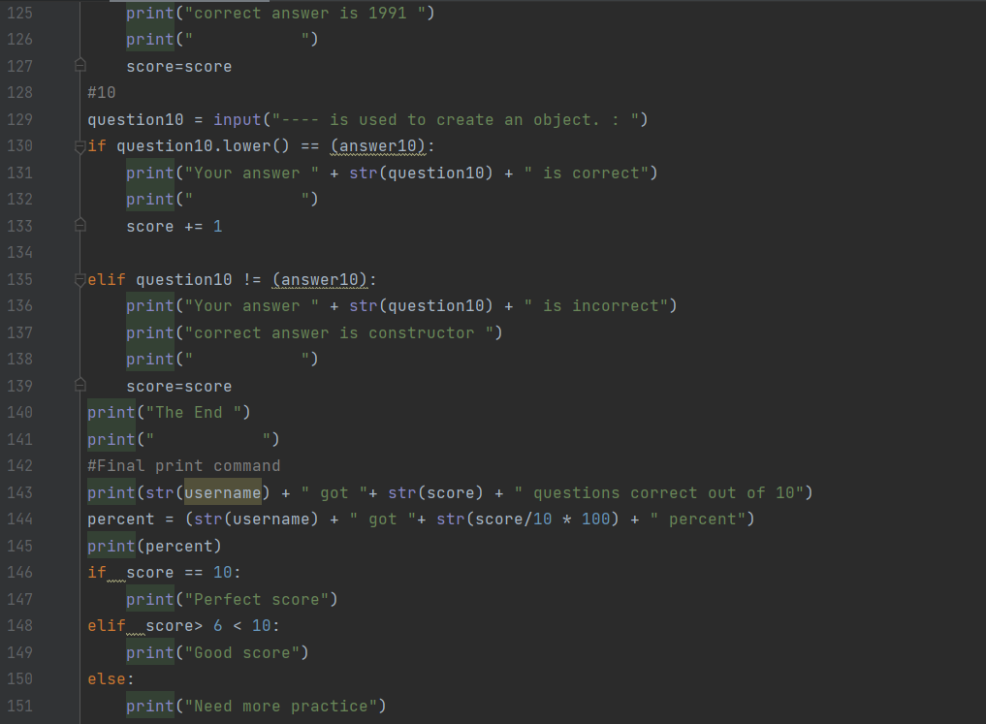
INPUT

Slide 18
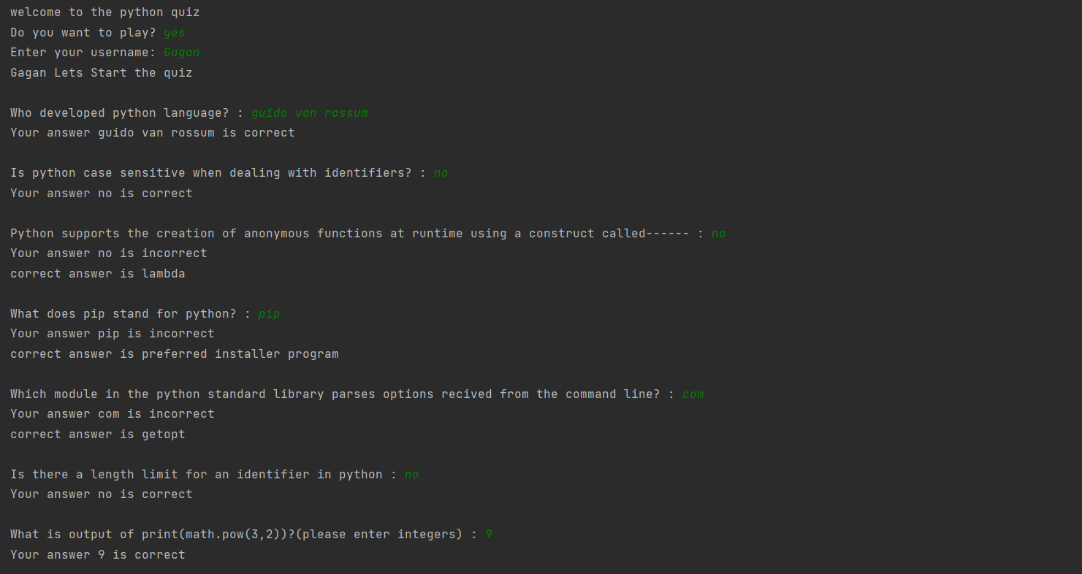
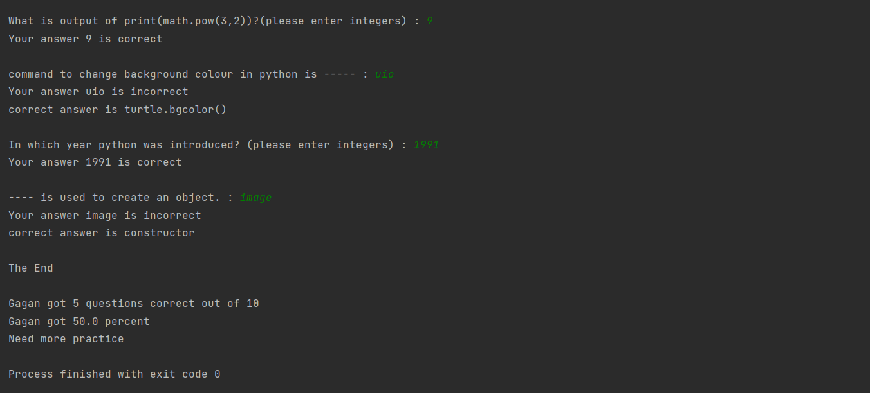
RESULTS

Slide 19
Future Scope
The Scope of this project is very broad in terms of gaining knowledge and sharing knowledge among world. Few points are:-
Can be used anywhere any time as it is a web-based application.
This application will be used in educational institutions as well as in corporate world.

Slide 20

Conclusion
This online quiz application provides facility to play quiz anywhere and anytime. It save time since user does need to wait for result. So, student/user cannot wait for the result. All Student/ user get extra knowledge and skills. Administrator has a privilege to put as much as question in any category given in application. User can register, log-in, and give the test with his/her specific id and can see the results as well.

